Slide 1
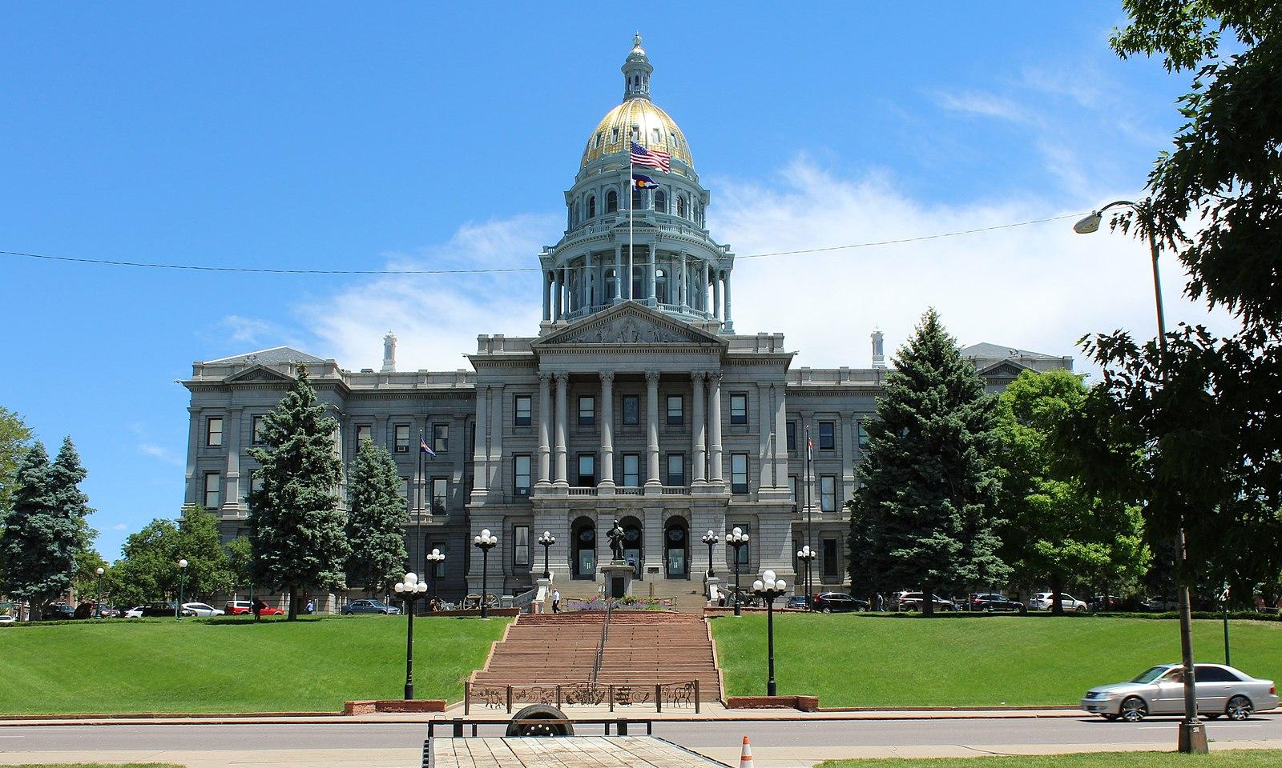
Securitization in Colorado:
Lessons Learned
Senator Chris Hansen, PhD
(D-Denver, CO District 31)

Slide 2
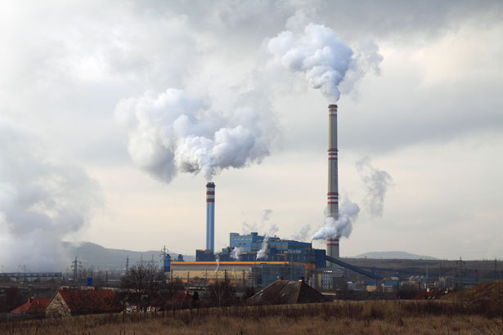
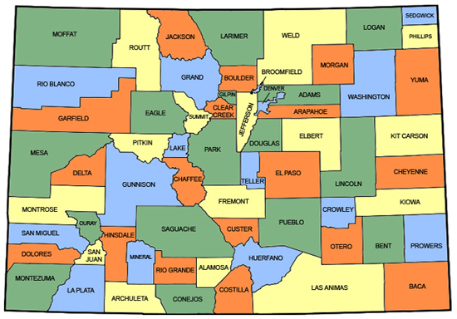
The Opportunity
Across the United States from 2011 to mid-2020, 95 gigawatts of coal capacity was closed or switched to another fuel and another 25 GW is slated to shut down by 2025*
Coal plant closures will accelerate, given the lower costs of alternative generation
Morgan Stanley projects that coal-fired electricity will decline from 27% of U.S. power in 2018 to just 8% by 2030.
Colorado should plan ahead for this eventuality and reduce the impact of closures on affected Colorado workers and communities.
Sources: *Energy Information Administration

Slide 3
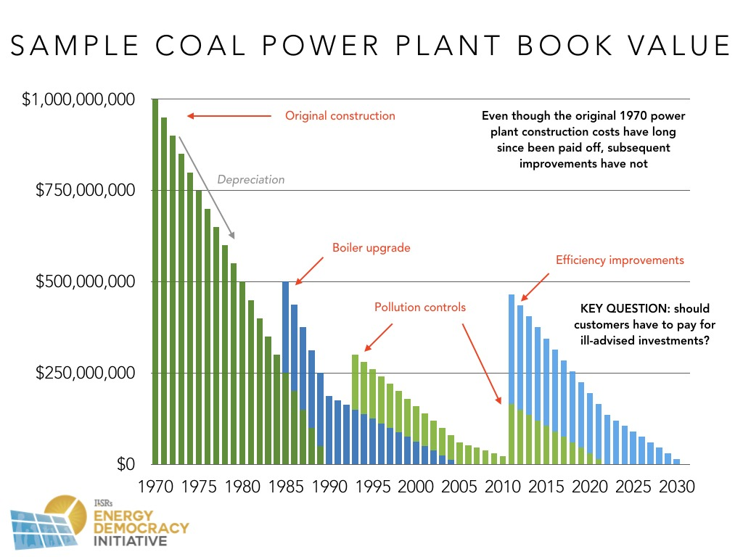
Source: Energy Democracy Initiative

Slide 4
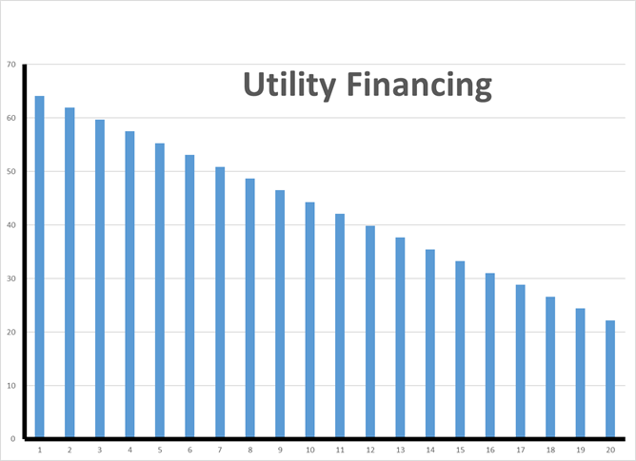
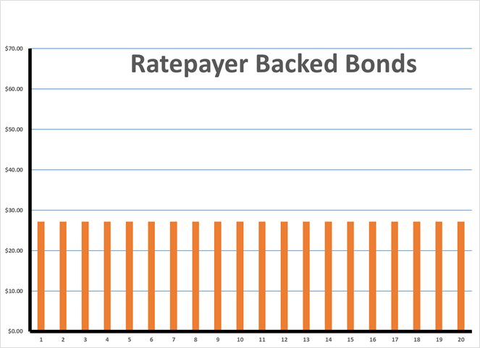
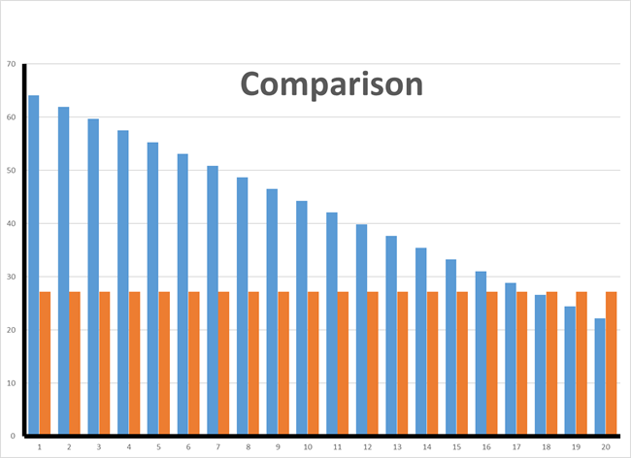
How to Finance the Stranded Costs Two choices:
Undepreciated Capital Costs

Slide 5
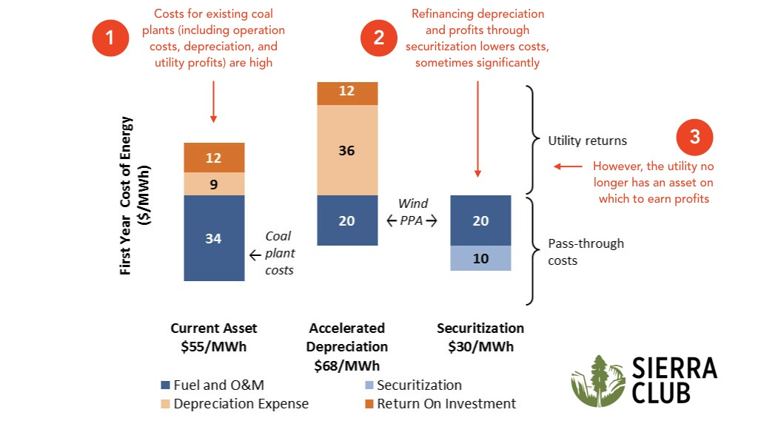
How Securitization Lowers Costs (Overview)
Source: Sierra Club

Slide 6
Sources of Utility Securitization Ratepayer NPV Savings
Source: Saber Partners, LLC
Notes:
Have securitized utility debt produced significant NPV savings for ratepayers compared to the traditional mix of utility debt and equity?

Slide 7
Savings Can Be Used For Several Purposes:
NPV Utility Financing
Savings
Savings Categories
Lower marginal cost of power
Smaller replacement portfolio
Lower fuel price risk
Uses:
Rate reductions for consumers
Retraining for affected workers
Property tax support for affected local government
$100m
$42m
NPV RBB Financing

Slide 8
Since 1997 Utility Securitization Laws: 25 States + DC + Puerto Rico Only 10 Active and Can Issue Now, 5 Considering Legislation, 4 New in 2019
√
√
√
√
Passed laws in 2018-20
√
√
√
√
States with Legislation
√
States Securitization Being Considered
√
√
√
States Securitization Active Legislation
√
Source: Saber Partners, LLC
Notes:
Is there a large supply of AAA-rated securitized utility debt available to investors?

